Slide 1



Noida Institute of Engineering and Technology, Greater Noida
Customer Relationship Management (AOE0865)
Unit: 3
Unit 3: Strategic and Operational CRM
Ms.Rachna Sharma
CSE(DS) Department
B Tech 8th Sem

Slide 2
Noida Institute of Engineering and Technology, Greater Noida
Customer Value - Concept
Definition:
The perceived benefit a customer receives compared to the cost of acquiring a product or service.
Significance:
Drives customer satisfaction and loyalty.
Key for long-term business profitability

Slide 3
Noida Institute of Engineering and Technology, Greater Noida
Sources of Customer Value
Functional Value: Performance and quality of the product.
Emotional Value: Emotional connection to the brand.
Economic Value: Cost savings and monetary benefits.
Social Value: Association with status or identity.

Slide 4
Noida Institute of Engineering and Technology, Greater Noida
Delivering Customer Value
Strategies:
Understand customer needs and expectations.
Offer superior product/service quality.
Build long-term relationships.
Personalize customer experiences.
Ensure efficient post-sale support.

Slide 5
Noida Institute of Engineering and Technology, Greater Noida
Strategic CRM
Definition: Focuses on managing customer relationships to achieve long-term business goals.
Key Elements:
Customer Portfolio Management (CPM)
CRM Tools and Strategies

Slide 6
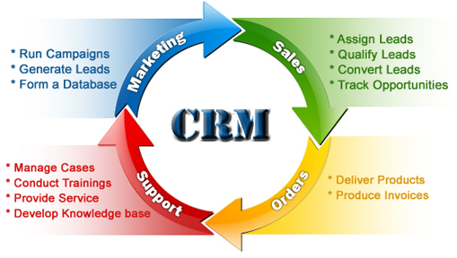
Noida Institute of Engineering and Technology, Greater Noida

Slide 7
Noida Institute of Engineering and Technology, Greater Noida
Customer Portfolio Management (CPM)
The process of categorizing and managing customer segments.
CPM Models:
ABC Analysis
RFM (Recency, Frequency, Monetary) Model
CLV (Customer Lifetime Value) Analysis
Strategies:
Prioritize high-value customers
optimize resource allocation, and enhance engagement.

Slide 8
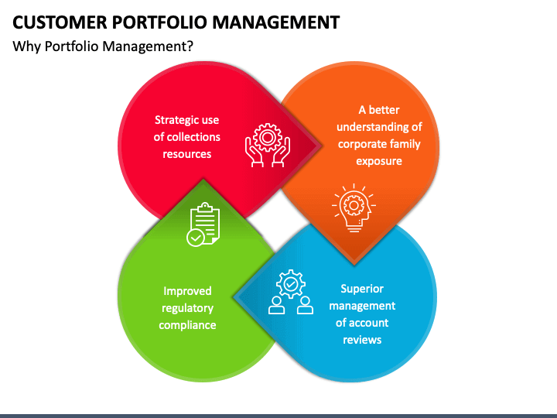
Noida Institute of Engineering and Technology, Greater Noida

Slide 9
Noida Institute of Engineering and Technology, Greater Noida
Operational CRM - Concept
Definition: CRM processes focused on automation and improving efficiency in sales, marketing, and service.
Key Features:
Salesforce Automation (SFA)
Marketing Automation
Service Automation
Visual: Diagram of operational CRM tools.

Slide 10

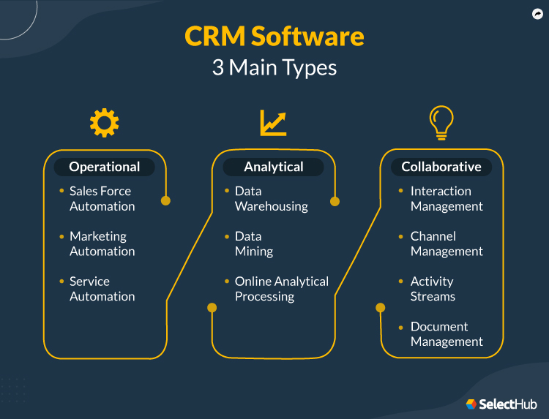
Noida Institute of Engineering and Technology, Greater Noida

Slide 11
Noida Institute of Engineering and Technology, Greater Noida
Salesforce Automation (SFA)
Definition: Automating sales processes to improve efficiency and performance.
Key Benefits:
Streamlined lead tracking.
Real-time data access.
Improved sales team performance.
Introduction to SFA Software: Salesforce, HubSpot, Zoho CRM.
Visual: Screenshot of an SFA dashboard.

Slide 12
Noida Institute of Engineering and Technology, Greater Noida
Service Quality - Concept
Definition: The customer’s perception of how well a service meets their expectations.
Types of Service Quality:
Core Service (essential services).
Peripheral Service (value-added services).
Visual: Matrix of core vs. peripheral services.

Slide 13
Noida Institute of Engineering and Technology, Greater Noida
Service Quality Gaps
Definition: Discrepancies between customer expectations and their actual experience.
Common Gaps:
Knowledge Gap.
Standards Gap.
Delivery Gap.
Communication Gap.
Perception Gap.
Visual: Diagram of the Service Quality Gap Model.

Slide 14
Noida Institute of Engineering and Technology, Greater Noida
Service Quality and Loyalty
Impact:
Superior service quality fosters loyalty.
Loyal customers contribute to repeat business and referrals.
Strategies:
Consistent service delivery.
Personalized experiences.
Visual: Flowchart linking service quality to loyalty.

Slide 15
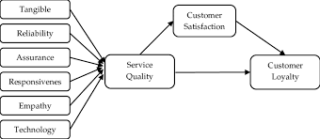

Slide 16
Noida Institute of Engineering and Technology, Greater Noida
Service Quality Measurement Scales
Common Scales:
SERVQUAL: Measures gaps between expectations and perceptions.
Net Promoter Score (NPS): Assesses likelihood of recommendation.
Customer Satisfaction Index (CSI).
Visual: Table comparing the features of SERVQUAL, NPS, and CSI.

Slide 17
Noida Institute of Engineering and Technology, Greater Noida
Delivering customer value involves all EXCEPT: a) Identifying customer needs b) Reducing customer expectations c) Aligning business processes to customer needs d) Providing superior product and service experiences
2. Which of the following is NOT a source of customer value? a) Product features b) Price advantage c) Poor after-sales service d) Emotional benefits
3. Customer Portfolio Management primarily focuses on: a) Managing company investments b) Segmenting customers based on their value c) Creating product portfolios d) Increasing product prices
4. Which model is commonly used in CPM for analyzing customer value? a) SWOT analysis b) RFM analysis c) PESTLE analysis d) Porter's Five Forces
5. What is the primary strategy of CPM? a) Maximizing the value of low-value customers b) Focusing on profitable customer relationships c) Reducing marketing expenses d) Ignoring customer retention
6. Which of the following is a key function of Operational CRM? a) Customer segmentation b) Salesforce automation c) Strategic planning d) Brand positioning

Slide 18
Noida Institute of Engineering and Technology, Greater Noida
7. Salesforce automation (SFA) refers to: a) Automating sales-related tasks b) Replacing the sales team with AI tools c) Implementing HR processes d) Increasing product costs
8. Which of the following is NOT a key feature of SFA software? a) Lead management b) Forecasting c) Employee payroll management d) Contact management
9. The gap between expected service and perceived service is known as: a) Delivery gap b) Communication gap c) Service quality gap d) Knowledge gap
10. Which of the following is a commonly used service
quality measurement scale? a) SERVQUAL b) SWOT c) RFM d) PEST

Slide 19

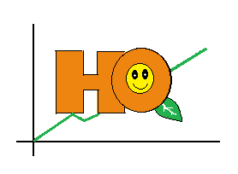
Thank You

